Slide 1

Building Management System (BMS) – Real-Time Data Engineering Pipeline
Presenter's Name: Mohamed Ahmed Abdelaziz
Date: 12-12-2025

Slide 2


Problem Description:
Buildings generate massive amounts of sensor data (temperature, humidity, CO₂, motion, energy).
Without a proper pipeline, this data becomes messy, unorganized, and difficult to analyze in real time — causing inefficiency, energy waste, and poor building performance decisions.

Slide 3
Overview of the proposed solution
A real-time data pipeline that simulates sensor data → streams it via Kafka → processes it using Spark (batch + streaming) → loads results into Apache Pinot → visualizes KPIs through Superset dashboards.
Unique Value Proposition
Real-time end-to-end data flow
Low-latency analytics with Pinot + Superset
Scalable for streaming and batch workloads
Enables key smart-building insights (energy & air quality

Slide 4
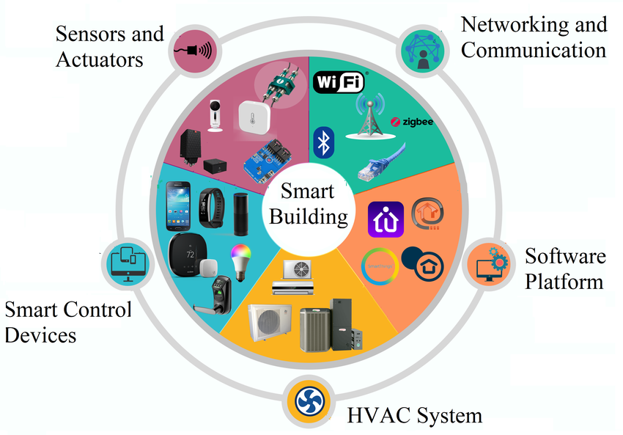

Project Wireframe
Visual representation
Sensor Simulation → Python
Streaming → Kafka
Processing → Spark
Real-Time Analytics → Apache Pinot
Dashboards → Superset
User Journey
Data generated → streamed → processed → stored → displayed live on dashboards
Focus
Clear, real-time data flow across all pipeline components

Slide 5


Primary Users:
-Facility managers & building operators
Key Features
- Real-time sensor monitoring (temp, CO₂, energy, occupancy)
- Alerts on abnormal readings
- Historical trend analysis
Benefits / Problem Solving
- Faster decisions & energy optimization
- Air quality & occupancy insights
- Prevents inefficiency & waste

Slide 6
Database Architecture:
Apache Pinot → columnar tables, optimized for real-time OLAP queries
Trino → connects Pinot to Superset for low-latency dashboard queries
Pinot handles high-throughput streaming data, supports aggregation & filtering
Key Entities & Relationships:
Sensors: temperature, humidity, CO₂, motion, energy
Readings: timestamped sensor data, includes sensor ID & value
Relationships: Sensors → Readings → Dashboards
Optional aggregations: avg, min, max per time window

Slide 7
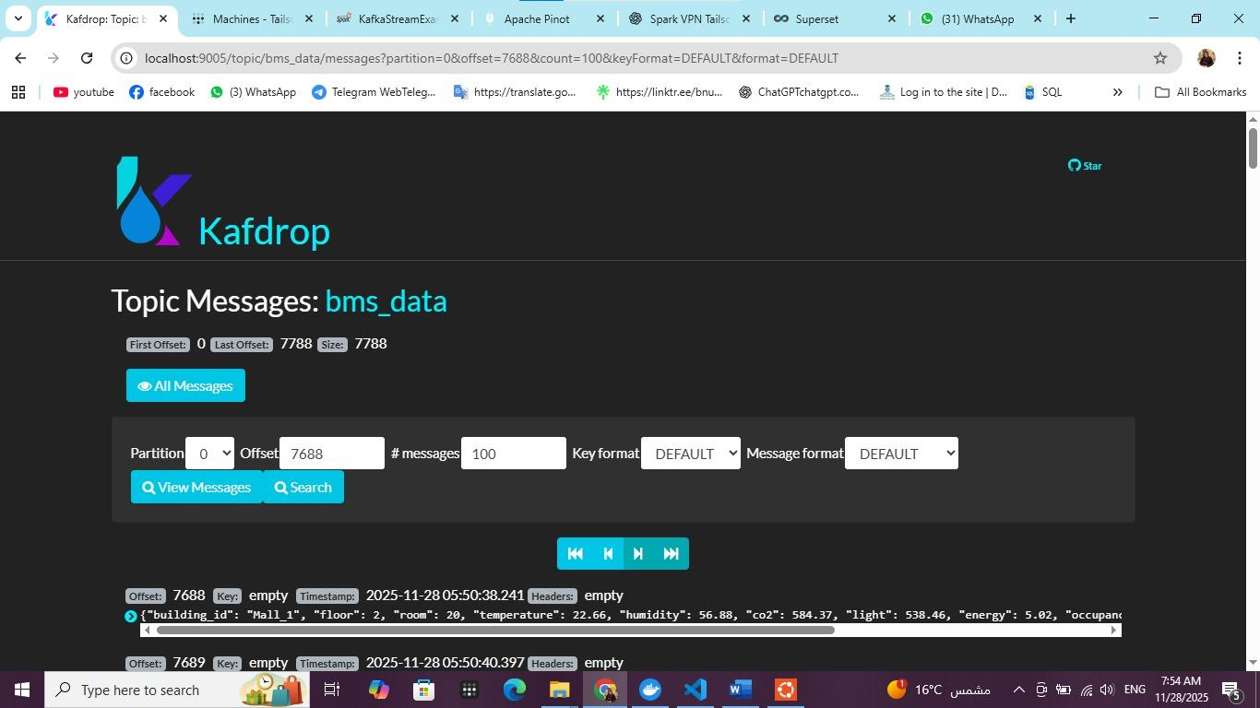
Kaf drop

Slide 8
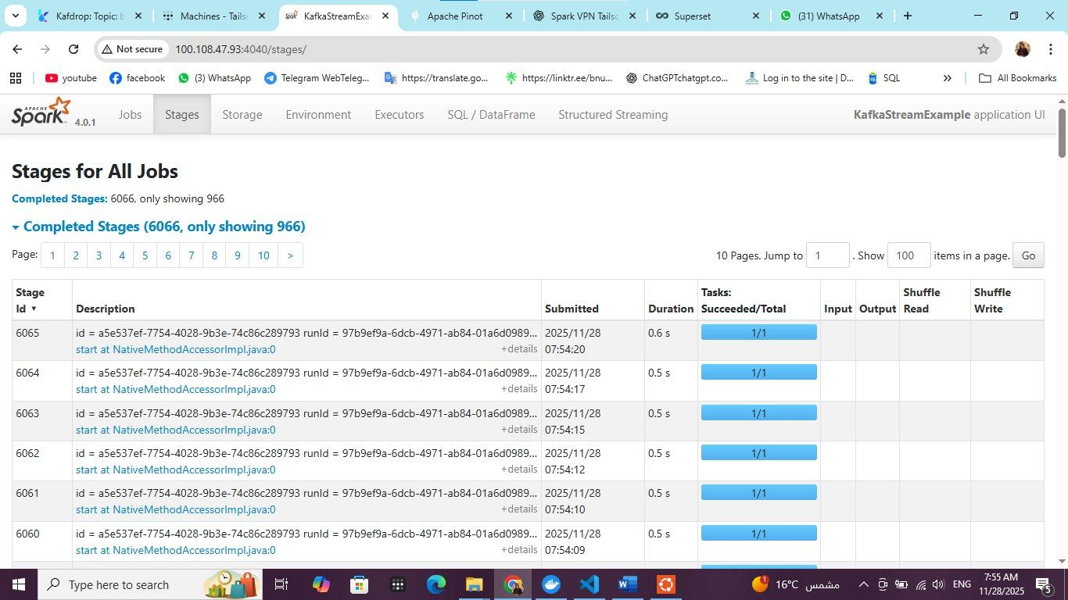
Spark

Slide 9
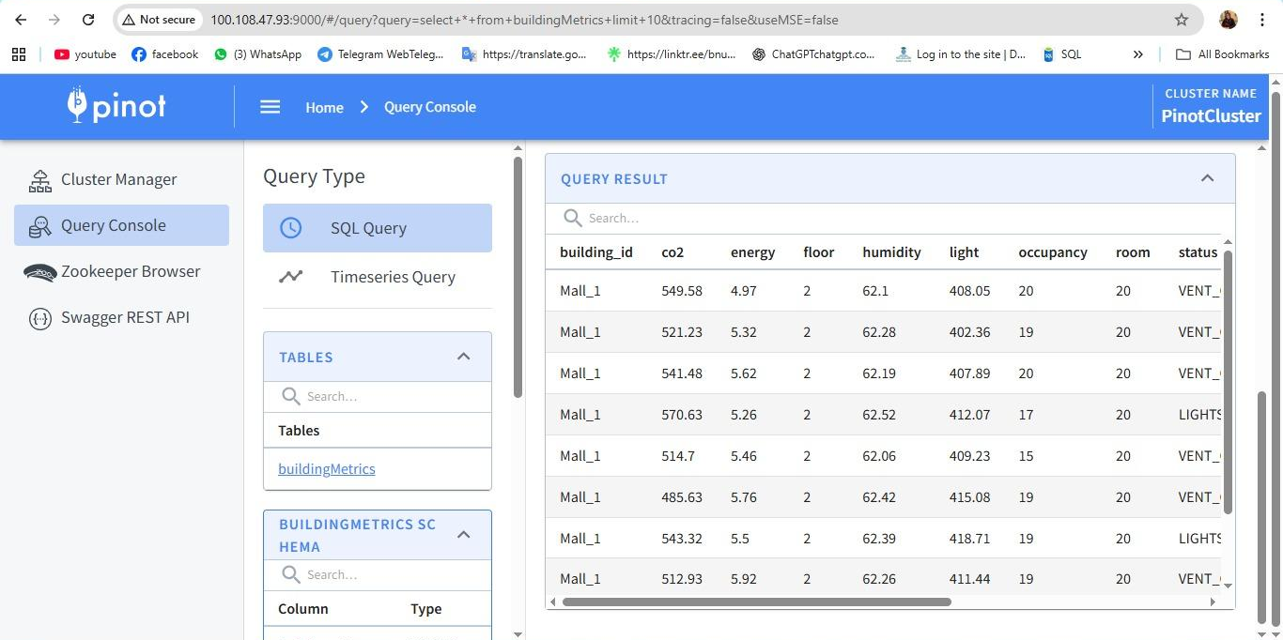
Pinot

Slide 10
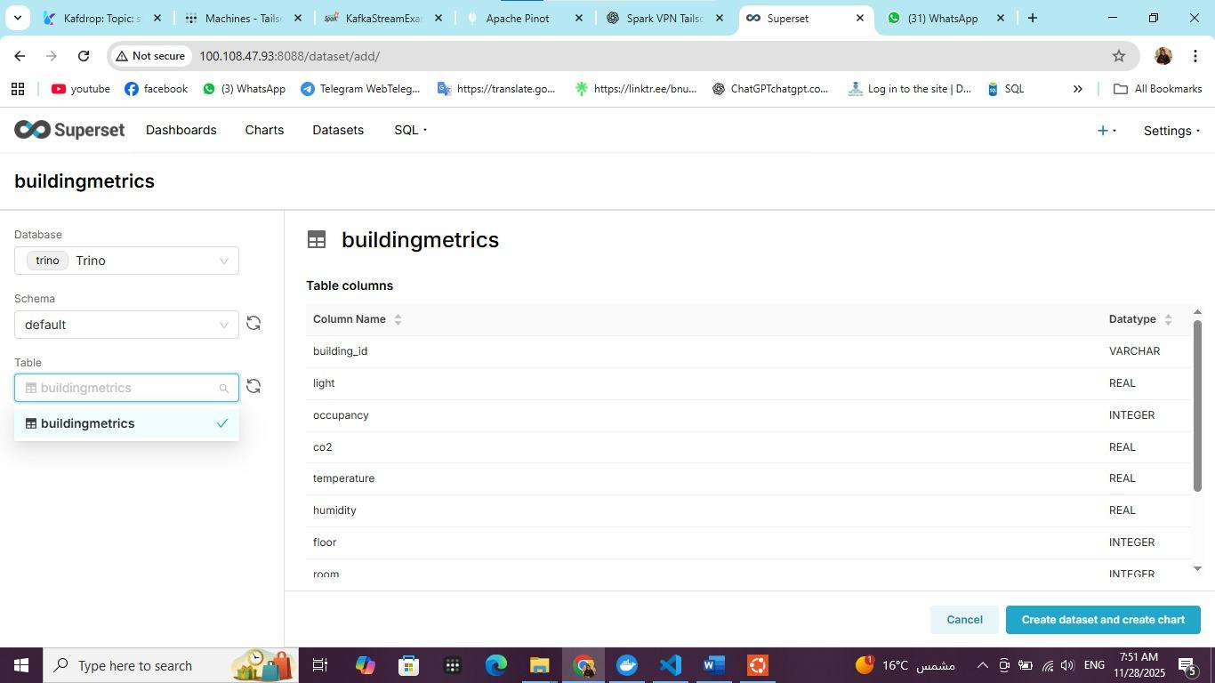
Super Set

Slide 11
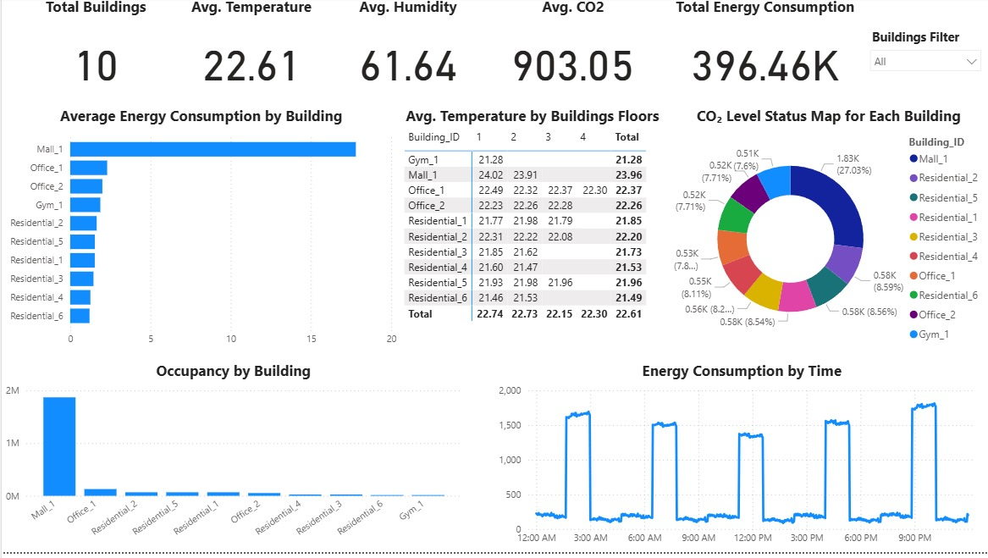

Slide 12
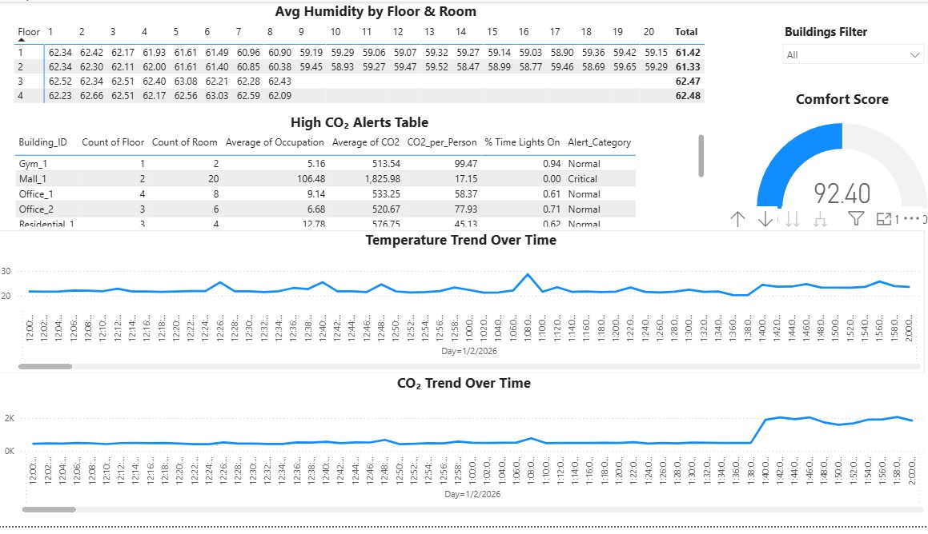

Slide 13
Data Flow:
Python generates real-time sensor data
Sent to Kafka topic bms_data
Spark consumes, processes, cleans, aggregates data and send it cleaned to a kafka topic named spark_data
Processed data stored in Pinot columnar tables
Trino queries Pinot → Superset dashboards
Dashboards show real-time KPIs: energy, occupancy, temp, CO₂ trends
Notes:
Fully streaming pipeline, no CSV
Handles continuous ingestion, processing, and visualization

Slide 14
Main Programming Languages:
Python → data simulation, streaming, processing
SQL → queries for Pinot via Trino
Frameworks / Tools:
Apache Kafka → real-time streaming
Apache Spark → batch & streaming processing
Apache Pinot → columnar real-time storage
Trino → query engine connecting Pinot to dashboards
Superset → visualization & dashboards
Supporting Technologies:
GitHub → version control
10/14/24

Slide 15
Current State:
Pipeline fully functional in beta
Data flows: Python → Kafka → Spark → Pinot → Superset
Dashboards display real-time KPIs
Testing Phases:
Unit Testing: Spark processing functions
Integration Testing: Kafka + Spark + Pinot + Superset
Functional Testing: Dashboards show accurate, real-time KPIs
Feedback / QA:
Dashboards responsive, KPIs correct , Low-latency updates , Minor adjustments on aggregation windows
10/14/24

Slide 16
Team Members & Roles:
Mohamed Ahmed: Team leader / Data Engineer → pipeline architecture & planning and data generation
Hanin Mohamed: Streaming →operating Kafka topics via docker
Rodina Amr: Data Processing → Spark batch & streaming
Youssef Tamer: Database → Pinot setup & performance
Ganna Ehab: Visualization → Superset dashboards
Mohamed Ibrahim: Documentation & QA → testing & report writing
Collaboration Methods:
Agile methodology, regular team meetings
Tools: GitHub, VS Code, Slack/Teams for communication
10/14/24

Slide 17
Notes
We used Tailscale vpn that provides a secure, private network layer that allows all components of our project to connect seamlessly across machines and environments without exposing any services to the public internet.
The project required using a large number of Bash commands to install, configure, and integrate all system components.
Each team member didn’t just complete their own tasks, but also contributed to other parts of the project to ensure everything worked smoothly.

Slide 18
Thank You
Contact Information:
Team GitHub Repository: https://github.com/MAAbdelaziz22/DEPI_Project
Questions & Feedback:
Open for any questions
Feedback is welcome to improve the pipeline and dashboards
10/14/24

